Slide 1

TRANSPARENCY in the supply chain
enables
informed decisions
EVERY DECISION an action to abolish slavery

Slide 2
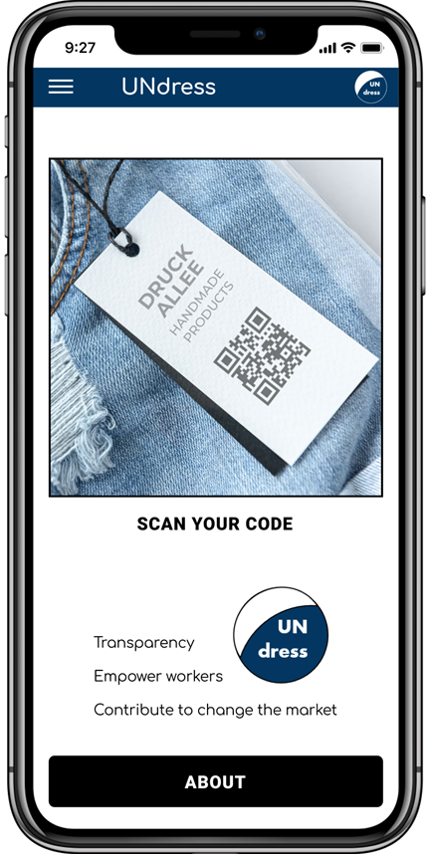
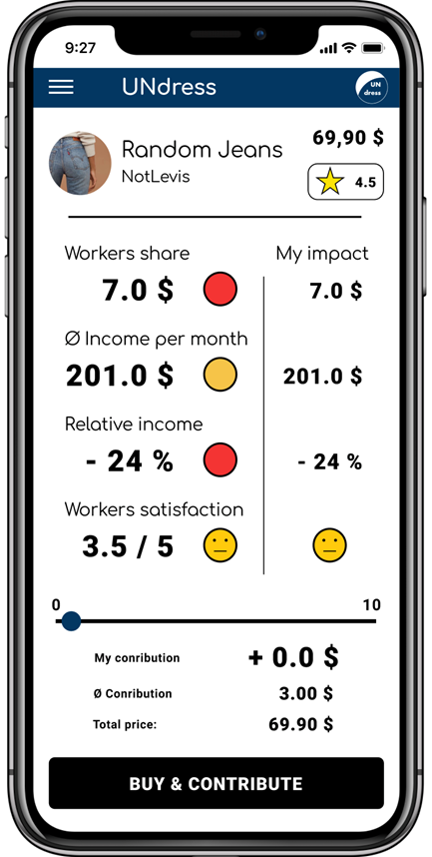
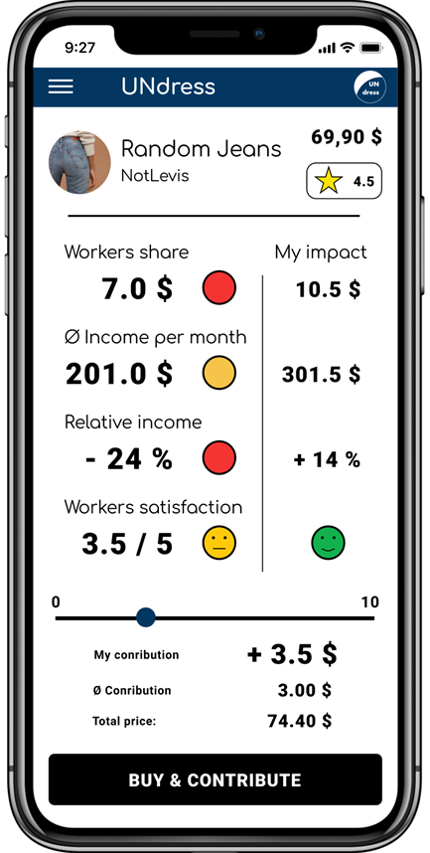
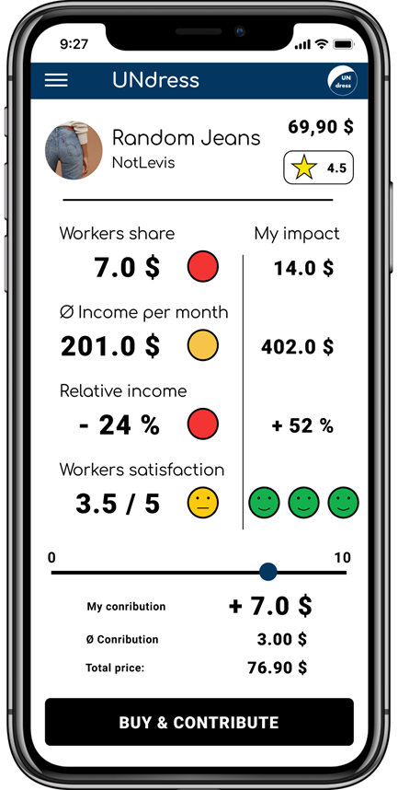
UNdress – Customer app demo

Slide 3
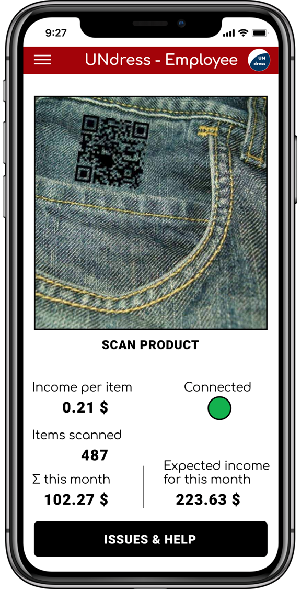
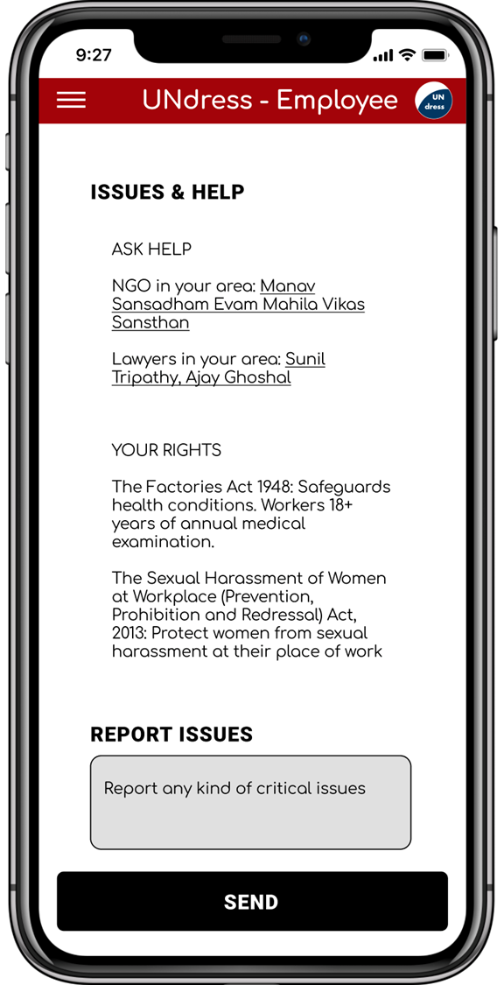
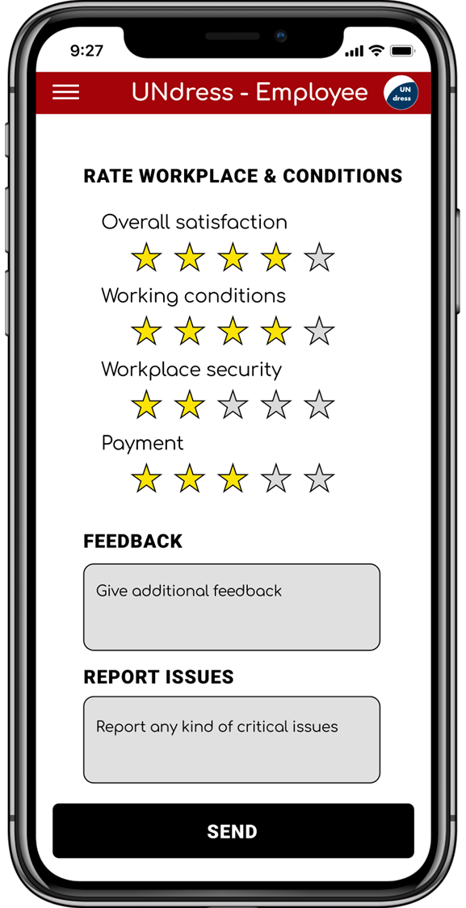
UNdress – Employee app demo

Slide 4


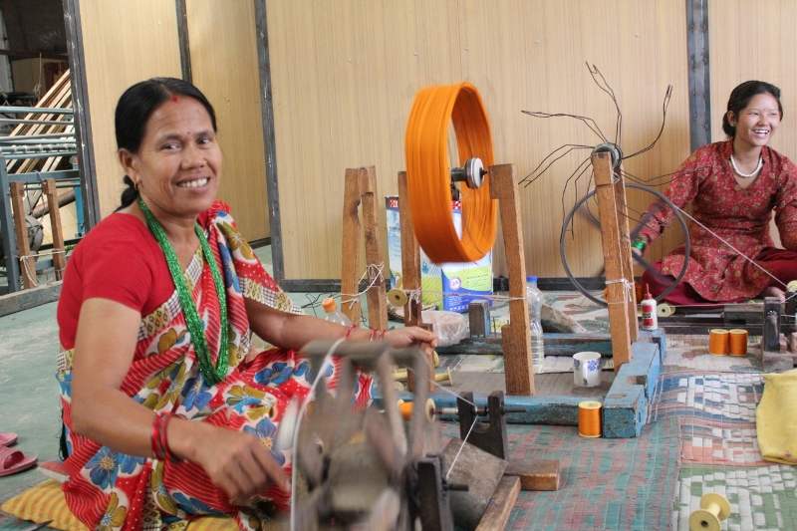
How does it work? Business Process Flow.
Customer
Company
Worker
download app
software and hardware
registration of products
registration with ID
set up smart contract
Notes:
Initiation

Slide 5
How does it work? Business Process Flow.
Worker
production cycle
produce item
scan item
instant payment
information
money $
data logged anonymize in block chain – payment via smart contract
Notes:
Production Cycle
>> Financial Security <<
instant payment
long-term contract
>> Appreciation <<
customers reviews
>> Enablement <<
NGO/ lawyers
awareness of rights
helpline/ chatbot

Slide 6
How does it work? Business Process Flow.
Worker
production cycle
monthly feedback
on demand issue report
information
money $
data logged anonymize in block chain – payment via smart contract
Notes:
Production Cycle
>> Financial Security <<
instant payment
long-term contract
>> Appreciation <<
customers reviews
>> Enablement <<
NGO/ lawyers
awareness of rights
helpline/ chatbot

Slide 7
How does it work? Business Process Flow.
Customer
Worker
buying cycle
scan product
receive information
make decision
donate
rate
buy
information
money $
data logged anonymize in block chain – payment via smart contract
Notes:
Buying Cycle
Power of
informed choice
support a fair market
change the market
reviews and feedback

Slide 8
How does it work? Business Process Flow.
Company
data insights
information
money $
data logged anonymize in block chain – payment via smart contract
Notes:
Data Insight
>> Data Insights <<
willingness to pay
rating of product
working conditions
fair salary
>> Brand Value <<
increased reach, reputation and prominence

Slide 9
How does it work? Business Process Flow.
Customer
Company
Worker
buying cycle
data insights
production cycle
scan product
receive information
make decision
monthly feedback
on demand issue report
donate
rate
buy
information
money $
data logged anonymize in block chain – payment via smart contract
Notes:
How does it work? Business Process Flow.

Slide 10
What’s in for me? Benefits on all sides.
Customer
Company
Worker
f
>> Transparency <<
>> Empowerment <<
>> Data Insights <<
>> Brand Value <<
>> Financial Security <<
>> Appreciation <<
>> Enablement <<
Notes:
Power of
informed choice
support a fair market
change the market
reviews and feedback

Slide 11
What’s in for me? Benefits on all sides.
Customer
Company
Worker
f
>> Transparency <<
>> Empowerment <<
>> Data Insights <<
>> Brand Value <<
>> Financial Security <<
>> Appreciation <<
>> Enablement <<
Notes:
>> Data Insights <<
willingness to pay
rating of product
working conditions
fair salary
>> Brand Value <<
increased reach, reputation and prominence

Slide 12
What’s in for me? Benefits on all sides.
Customer
Company
Worker
f
>> Transparency <<
>> Empowerment <<
>> Data Insights <<
>> Brand Value <<
>> Financial Security <<
>> Appreciation <<
>> Enablement <<
Notes:
>> Financial Security <<
instant payment
long-term contract
>> Appreciation <<
customers reviews
>> Enablement <<
NGO/ lawyers
awareness of rights
helpline/ chatbot

Slide 13
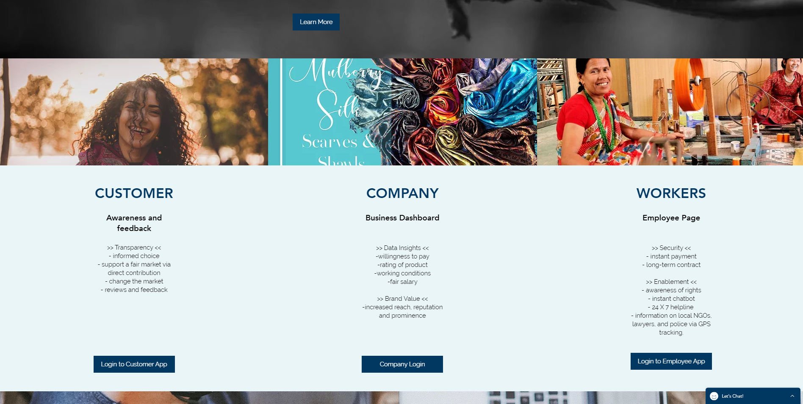
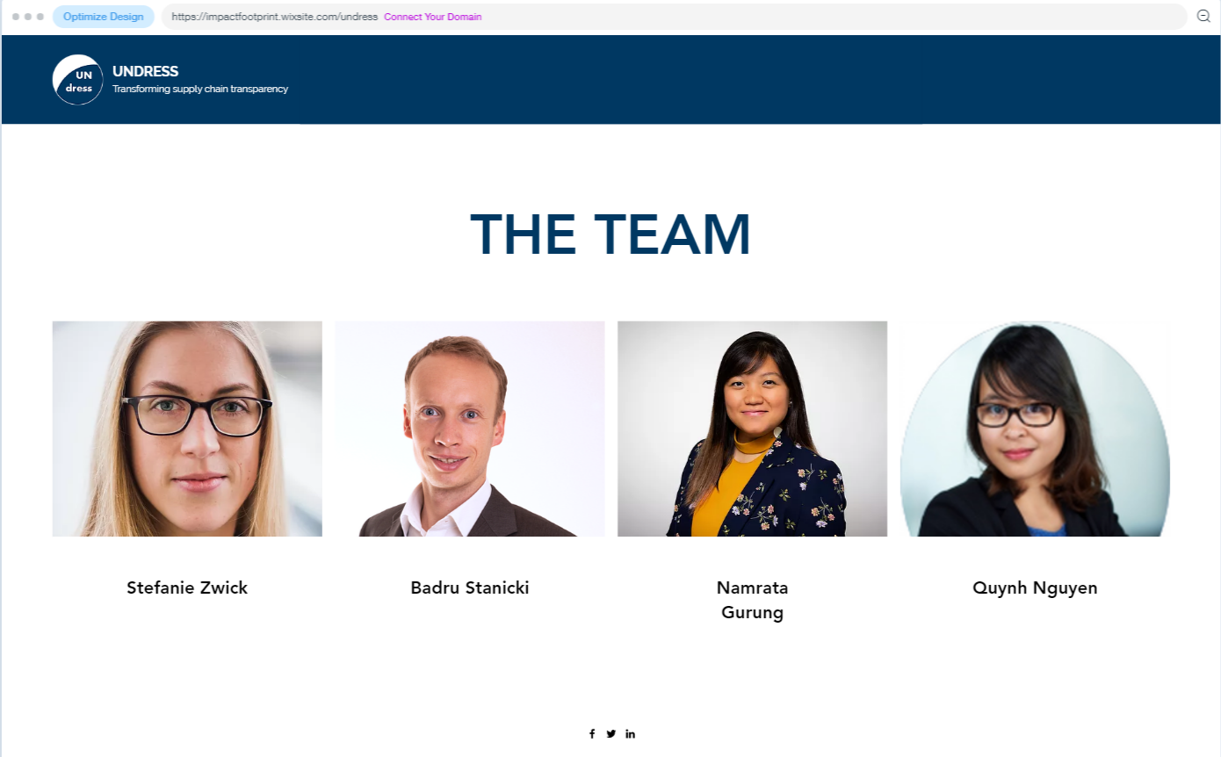

Excited? Find out more on our webpage.

